Slide 1
How to Control
Unity Objects from
Arduino

Slide 2
Before you Start…
Ensure you have followed the steps in the Setup Guide
Unity installed
Ardity package installed & set up
Arduino IDE installed & set up

Slide 3
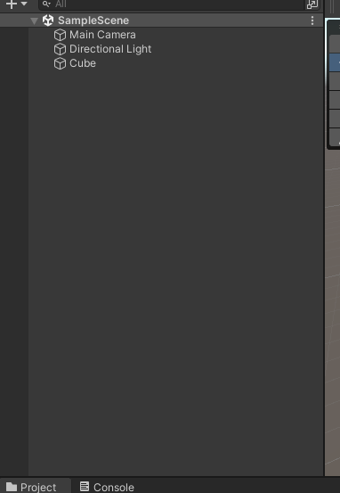
Creating an Object
Right click on the Hierarchy area on the left
Create a new Cube 3D object
3D Object > Cube

Slide 4
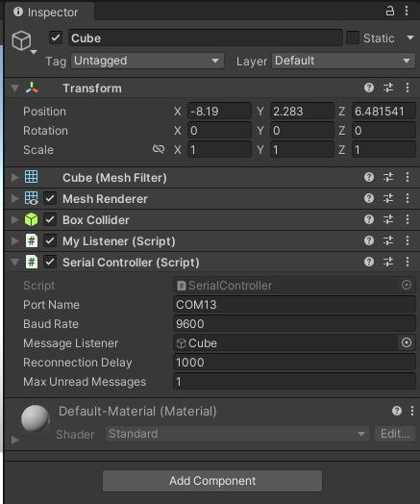
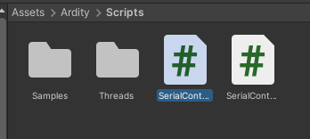
Adding Code to the Cube
Go to Assets > Ardity > Scripts
Click on the Cube object
Drag “SerialController.cs” into the Cube inspector area
Drag the code file into the space on the right

Slide 5
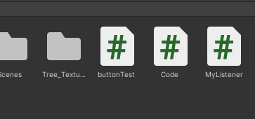
Adding Code to the Cube
Download “MyListener.cs” & move it to Assets
Click on the Cube object
Drag “MyListener.cs” into the Cube inspector area
Drag the code file into the space on the right

Slide 6
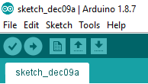
Arduino Code
Download & open Sketch dec8a.ino
Upload the code into your Arduino
Ensure you go to Tools and select the correct port and board type

Slide 7
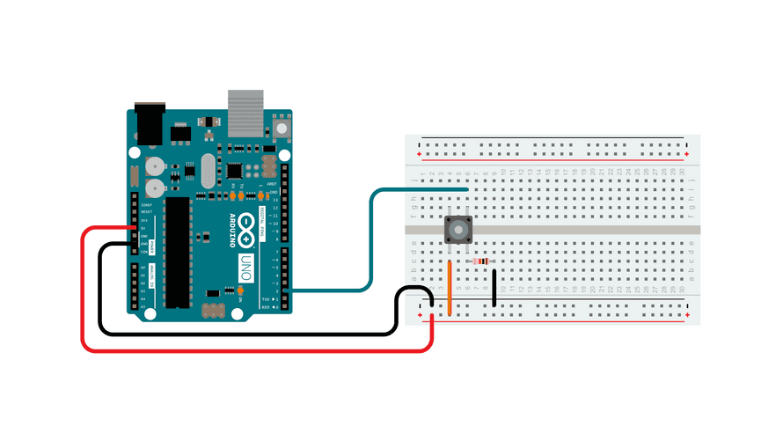
Arduino Circuit Setup
Notes:
https://docs.arduino.cc/built-in-examples/basics/DigitalReadSerial

Slide 8
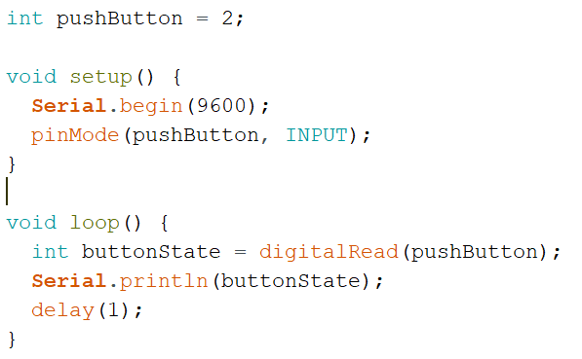
More about the Arduino Code…
Setup
Begins serial clock at 9600 Baud Rate
Sets pin 2 to input mode
Loop
Reads the signal from the button (on or off)
Sends the signal into the serial port
Waits for 1 second

Slide 9
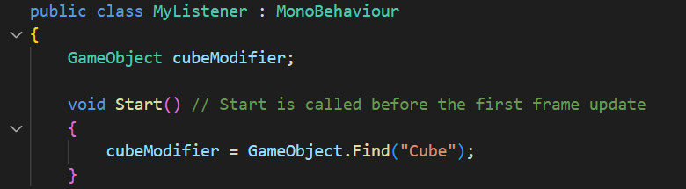
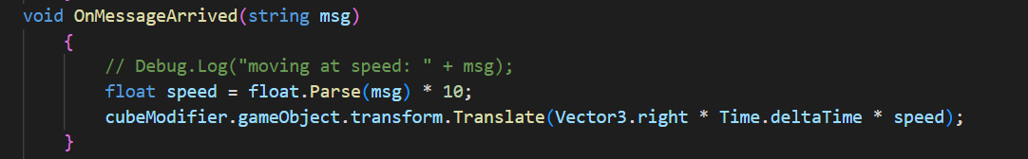
More about the C# Code…
MyListener.cs
Initialise cube modifier as game object
Sets speed variable to the message received from Arduino times 10
Moves cube to the right

